Slide 1
Natural Language Processing
Bible Vs Koran
by Alex Dance

Slide 2
Background
Have completed the ability to compare multiple aspects of text analysis on large documents / text in tables or form web scraping.
Why Bible Vs Koran: Am not particularly interested in religion or the benefits of a religion vs the other. This is purely statistical and use the tools. Seeing results on their own is partially interesting – but a comparison is more interesting. An alternative comparison could be something like Emily Bronte Vs JK Rowling.

Slide 3
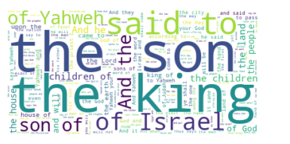
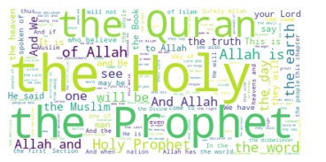
WordCloud
Bible
Koran

Slide 4
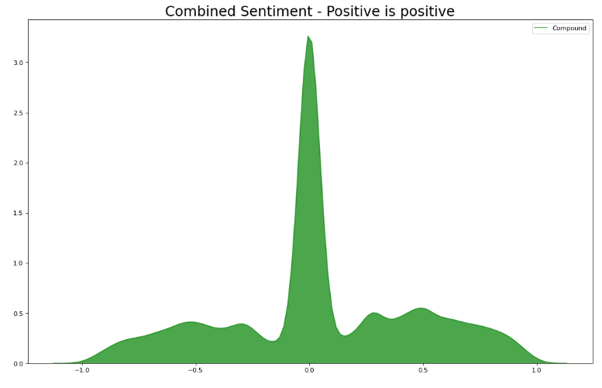
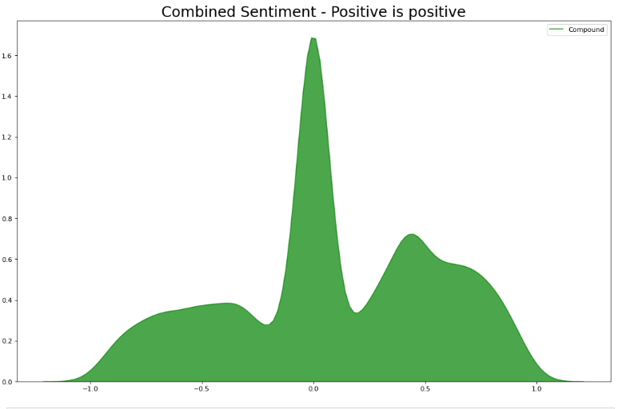
Sentiment
Bible
Koran
Bible has more neutral sentiment
Line is at 0.5
Koran is more positive
Line is at 0.5

Slide 5
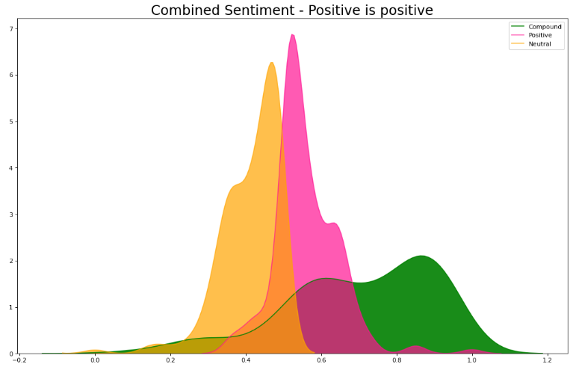
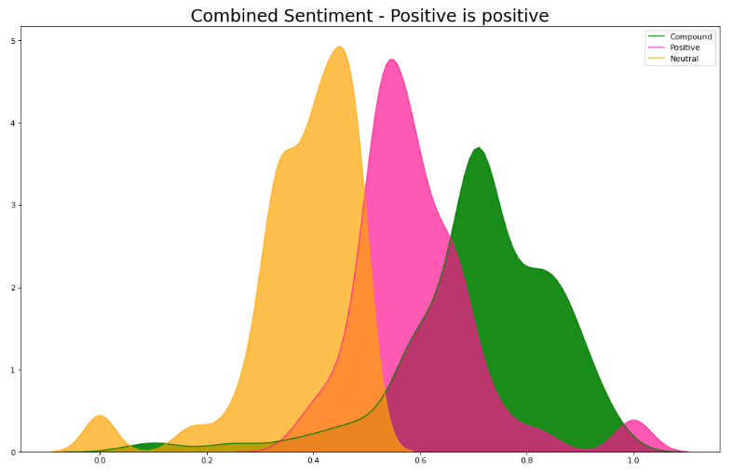
Sentiment
Bible
Koran

Slide 6
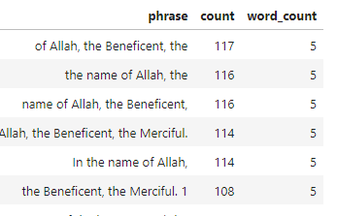

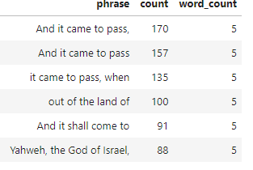

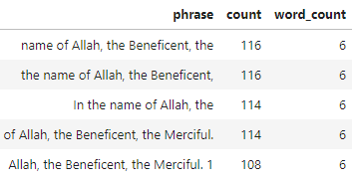
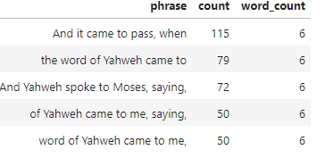
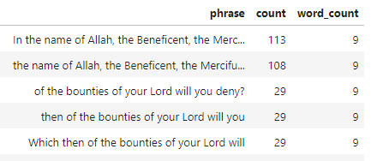
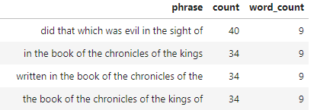
Grouped Words and phrases
Bible
Koran

Slide 7
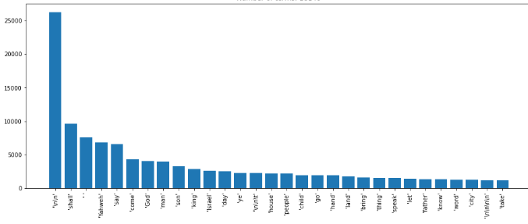
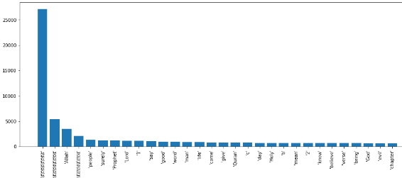
Main Plot Words (excluding stop words eg the)
Bible
Koran
Note: includes some spacing in document eg”/n” etc that can be ignored

Slide 8
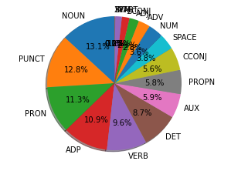
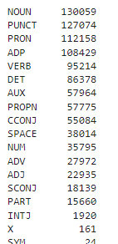
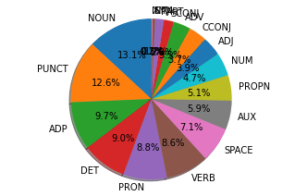
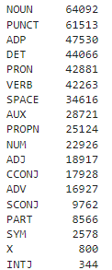
Parts of Speech
Bible
Koran
Bible has higher % of Pronouns

Slide 9


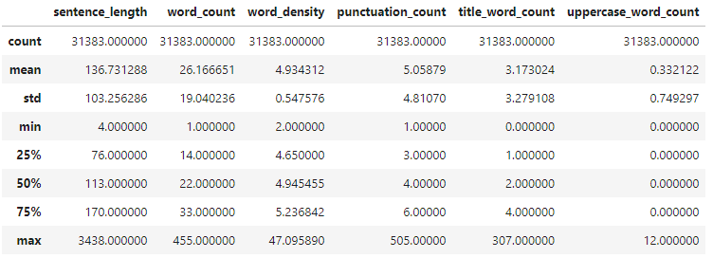
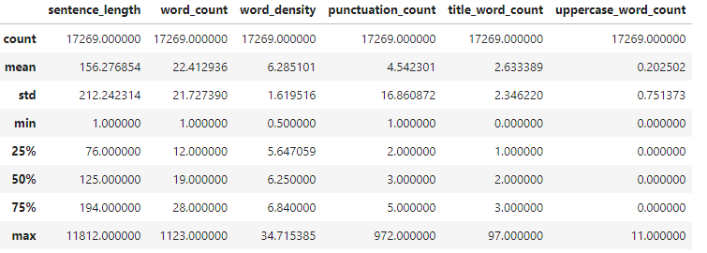
Sentences and Length
Bible is about twice as long
Bible
Koran
Koran has longer sentences

Slide 10
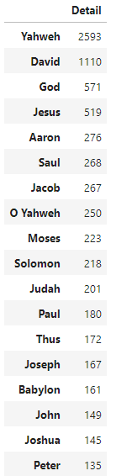
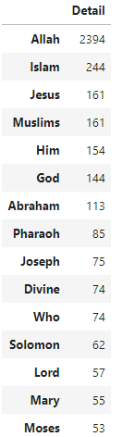
Main People
Bible
Koran
Yahweh is the most mentioned person in the bible
Jesus is 3rd most mentioned person in Koran

Slide 11
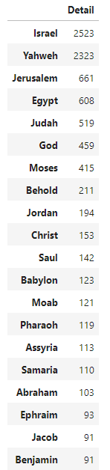
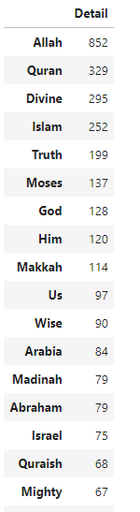
Places
Bible
Koran
Categorisation is not perfect

Slide 12
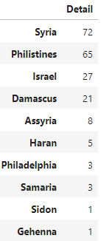
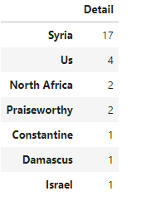
Location
Bible
Koran

Slide 13
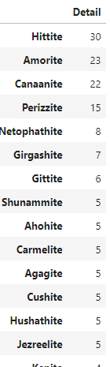
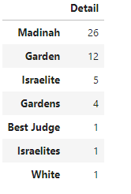
Facilities
Bible
Koran

Slide 14
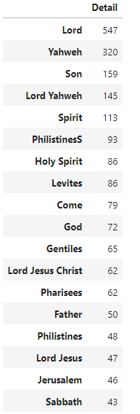
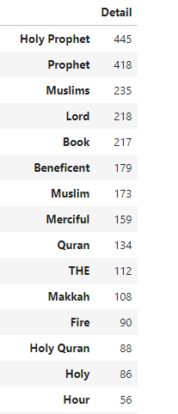
Orgs
Bible
Koran

Slide 15
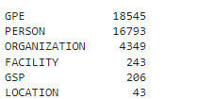

Types
Bible
Koran

Slide 16
Some Misspelled words (by current standards)
Bible
Koran
regene', 'hady', 'saq', 'yukhlifu', 'rejecters', 'ishmaelites', 'hawazin', 'inviter', 'dighth', 'showjou', 'gression', 'charac', 'ihram', 'fited', 'shment', 'nize', '22w', 'thamma', 'suraqa', 'lishing', 'ference', '59m', 'fection', 'disburses', 'cance',
'oznites', 'kengkreia', ''', 'admah', '52this', 'perverseness', 'asahel', 'jezrahiah', 'maaz', '67then', '35see', 'hodaviah', '7for', '54he', 'jeshaiah', 'theudas'ginath', 'lampstands', 'vaniah', 'haft', 'intimidations', 'quaestiones', 'birsha', 'jether', '62the', 'baladan', 'harhur', 'zophar', 'iturea',

Slide 17

Thanks
Alex Dance
Copy of This Presentation and code
https://github.com/alexdance2468/
Plus other data science projects completed
Contact Details
www.linkedin.com/in/alex-dance/
alexdance2468@gmail.com
0414 293 628

